Slide 1
1
Foundations of Information Systems in Business

Slide 2
What is Information system ?
An information system is an arrangement of people, data, processes, interfaces, networks, and technology that interact to support and improve both day-to-day operations (data processing, transaction processing), as well as support the problem-solving and decision-making needs of management (information services, management information systems, executive support).

Slide 3
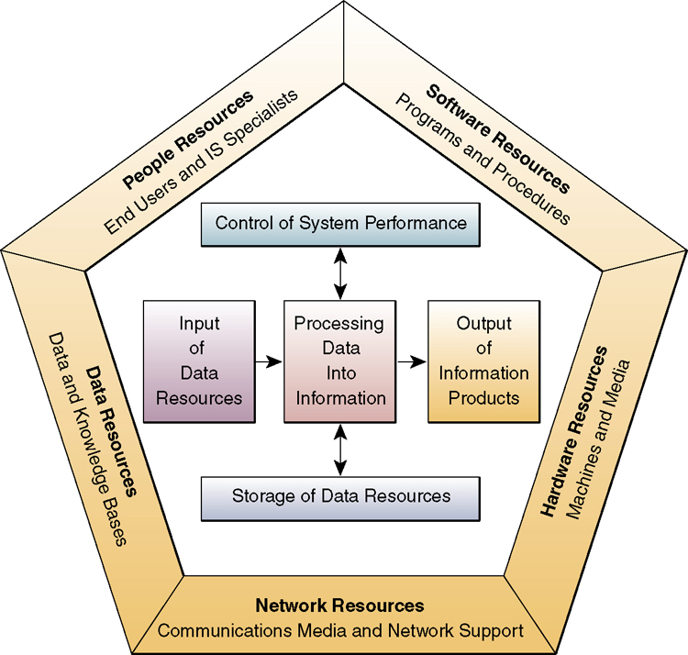
Components of an Information System
Notes:
The information system model shown on the slide highlights the relationships among the components and activities of information systems:
People Resources. People are required for operation of all ISs. People resources include:
End Users. As mentioned, these people use the IS or the information it produces.
IS Specialists. These people develop and operate the IS.
Hardware Resources. These include all the physical devices and materials used in information processing, including all machines and data media. Key components include:
Computer Systems. These are the CPUs and their related peripherals, such as terminals and networked PCs.
Computer Peripherals. These are input and output devices like keyboards, monitors, and secondary storage.
Telecommunications Networks. These are the computer systems interconnected by various telecommunications media such as modems.
Software Resources. These include all sets of information processing instructions. Software resources include:
System Software. This controls the computer.
Application Software. These are for a specific end user task, such as word-processing.
Procedures. These are the operating instructions for the people who use the IS.
Data Resources. Data is both the raw material of and among the most valuable organizational resources in the IS. Data can be in alphanumeric, text, image and/or audio form. Data are typically organized into either Databases - which hold processed and organized data; or Knowledge bases - which hold knowledge in a variety of forms such as facts and rules of inference about a given subject.

Slide 4
Components of an Information System
People
Information
Systems
Resources
Hardware
Software
Networks
Data
Notes:
An Information System is an organized combination of people, hardware, software, communications networks, and data resources that collects, transforms, and disseminates information in an organization.
Key concepts of the text include:
Information Technology (IT). The dynamic interaction of computer-based information systems with telecommunications forms the backbone of IT.
End User Perspective. An end user is anyone who uses an information system or the information it produces. As a perspective on management information systems, the end user focuses designers, developers, and all information systems personnel on how the system does and should function in use. Information systems are powerful tools -- and all the more powerful when made to fit the needs of those who use them everyday. This involves adapting the system to the user, not the other way around.
An Enterprise Perspective. Information technology can provide the information a business needs for efficient operations. It can even be the foundation of a company's competitive advantage. But to function properly, an information system must be developed in support of the strategic objectives, business operations, and management needs of the enterprise.
Discussion Note: To emphasize how important the seamless integration of each component of the information system is, ask students to make an argument excluding each element in turn. The necessity of interdependence soon becomes clear.

Slide 5
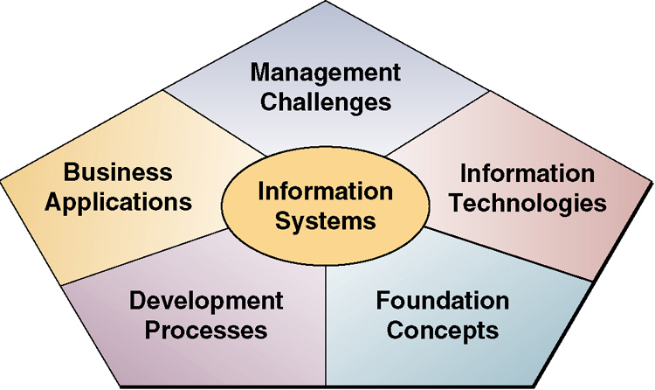
An IS Framework for Business Professionals
Notes:
Five areas of knowledge are important to end users in order to understand information systems:
Foundation Concepts. End users must be familiar with with the basic components and types of information systems there are. But they also need to be familiar with general systems theory and theories of information processing (machine and human). These topics are covered in Chapters 1 and 2.
Information Technology. End users should understand technology, more precisely, the information technology of hardware, software, telecommunications, database management, and how all these elements interaction in a dynamic process of very rapid change, development, and new ways of doing business (See Chapters 3-6).
Business Applications. How information systems are applied to business problems is more complex than it might seem. The informed end users seeks to learn both about how to use information systems to solve existing problems and to begin using IS as a new way of defining problems and meeting business opportunities. End users should gain a basic understanding in the areas of user needs, office automation, transaction processing, the functional areas of business, management reporting, decision support, executive support, competitive advantage, and artificial intelligence (Chapters 7 - 9).
Development Processes. End users of IS need to know the fundamental concepts of problem-solving and development. Here you should become familiar with methodologies such as the systems approach, the systems development life cycle, and prototyping (Chapter 10).
Management Challenges. How managers make use of IS resources is a key concern for end users. More than ever, a knowledge of management methods is required by each end users, as IT demands that end users make more independent decisions that support the company's overall objectives. Key issues such as information resource management, global IT management, and information systems planning, implementation, and control are covered in Chapters 11 - 12, and throughout the text.

Slide 6
Major Roles of Information Systems
Support
Strategies for
Competitive Advantage
Support
Business Decision Making
Support
Business Processes and Operations
Notes:
Information Technology is increasingly important in the competitive marketplace. Managers need all the help they can get. Information systems perform three vital roles in business:
Support Business Operations. From accounting to tracking customers' orders, information systems provide management with support in day-to-day business operations. As quick response becomes more important, the ability of information systems to gather and integrate information across business functions is become crucial.
Teaching Tip: For example, the ability to match a change in product items sales with as a result of a new marketing campaign to the inventory and ordering system, can help keep items in high demand in stock.
Support Managerial Decision Making. Just as information systems can combine information to help run the business better, the same information can help managers identify trends and to evaluate the outcome of previous decisions. IS helps managers make better, quicker, and more informed decisions.
Support Strategic Advantage. Information systems designed around the strategic objectives of the company help create competitive advantages in the marketplace.
Teaching Tip: For example, Wal-Mart stores can provide lower prices in part due to the lower costs incurred by their state-of-the art computerized inventory, tracking, and distribution system.

Slide 7
What is a System?
Environment
Control by
Management
Feedback
Signals
Feedback
Signals
Control
Signals
Control
Signals
Input of
Raw Materials
Manufacturing
Process
Output of
Finished Products
System Boundary
Other Systems
Notes:
System concepts underlie the field of information systems. From the end user perspective, it is necessary to understand the fundamentals of systems theory:
System. A system is a group of interrelated components working together toward a common goal by accepting inputs and producing outputs in an organized transformation process. Systems have the following three basic interacting functions.
Input. Input involves capturing and assembling elements that enter the system to be processed.
Processing. Processing involves the transformation of input into output.
Output. Output is the end result of the transformation process. Output involves transferring elements that have been produced by a transformation process to their ultimate destination.
Teaching Tip: You might want to introduce the concept of "value-added" in relation to system transformation. The changes that occur during processing are typically worth more to someone outside the system, such as a customer, than the costs involved in making the transformation.

Slide 8
Data versus Information
Monthly Sales Report
for West Region
1200 100
West Charles Mann
79154 TM Shoes
Sales Rep: Charles Mann
Emp No. 79154
Item Qty Sold Price
TM Shoes 1200 $100
Notes:
Data:
Data is the plural of datum, though data commonly represents both singular and plural forms.
Data are raw facts or observations, typically about physical phenomena or business transactions.
Data should be viewed as raw material resources that are processed into finished information products.
Data are usually subjected to a value-added process (data processing or information processing) where
Its form is aggregated, manipulated, and organized
Its content is analyzed and evaluated
It is placed in a proper context for a human user
Information:
Information can be defined as data that have been converted into a meaningful and useful context for specific end users.
Information should be viewed as processed data which has been placed in a context that gives it value for specific end users.

Slide 9
IT Era’s
Data Processing (DP)
Micro Era
Network Era
WAN Network Environment
Client-Server
Thin Client
Web
WAP

Slide 10
History of the role of Information Systems
1950-1960
1960-1970
1970-1980
1980-1990
1990-2000
Data
Processing
Management
Reporting
Decision
Support
Strategic &
End User
Electronic
Commerce
Electronic
Data
Processing
- TPS
Management
Information
Systems
Decision
Support
Systems
- Ad hoc
Reports
End User
Computing
Exec Info Sys
Expert Systems
SIS
Electronic
Business &
Commerce
-Internetworked
E-Business &
Commerce
Notes:
Data Processing: 1950s - 1960’s:
Electronic data processing systems. Transaction processing, record-keeping, and traditional accounting applications
Management Reporting: 1960s - 1970’s:
Management Information systems. Management reports of prespecified information to support decision making.
Decision Support: 1970s - 1980s:
Decision Support systems. Interactive ad hoc support of the managerial decision-making process.
Strategic and End User Support: 1980s - 1990’s:
End User computing systems. Direct computing support for end user productivity and work group collaboration.
Executive information systems. Critical information for top management
Expert systems: Knowledge-based expert advice for end users
Strategic Information Systems. Strategic products and services for competitive advantage
Electronic Business and Commerce: 1990’s - 2000’s:
Internetworked e-business and e-commerce Systems. Internetworked enterprise and global e-business operations and e-commerce on the Internet, intranets, extranets, and other networks.

Slide 11
The e-Business Enterprise
The Internet
Suppliers and Other Business Partners
Company
Boundary
Supply Chain Management
Procurement, Distribution, and Logistics
Extranets
Engineering &
Research
Manufacturing
and
Production
Accounting,
and Finance
Intranets
Customer Relationship Management
Marketing Sales Customer Service
Extranets
Consumer and Business Customers
Notes:
The Internet and related technologies and applications is revolutionizing the way businesses are operated and people work, and how information technology supports business operations and end user work activities.
Businesses are quickly becoming e-business enterprises.
The Internet and Internet-like networks - inside the enterprise (intranets), and between an enterprise and its trading partners (extranets) - have become the primary information technology infrastructure that supports the business operations of many companies.
E-business enterprises rely on such technologies as to:
1. Reengineer and revitalize internal business processes
2. Implement electronic commerce systems among businesses and their customers and suppliers.
3. Promote enterprise collaboration among business teams and workgroups.
E-Business: is defined as the use of Internet technologies to internetwork and empower business processes, electronic commerce, and enterprise communication and collaboration within a company and with its customers, suppliers, and other business stakeholders.

Slide 12
Why Information System
The competitive Business Environment and the Emerging digital firm
Emergence and strengthening of the global economy
Formation of industrial economy into knowledge and information service economies.
Transformation of business enterprise
Emergence of digital firm.

Slide 13
Emergence of global economy
The success of firms today and in future depends on their ability to operate globally.
IS provide communication and analytic power that firm need to operate globally.
IT and globalization bring new threats to domestic business

Slide 14
Transformation of industrial Economies
Industrial economies has been transformed in to knowledge and information based economies.
Knowledge and information are becoming the foundation for many new services.
Knowledge intense products

Slide 15
Transformation of the business enterprise
New style of business firm is
Less hierarchical
Decentralized
Flexible arrangements of generalists
New managers rely on
Flexible teams
Informal commitments and networks
Customer orientation

Slide 16
The emerging digital firm
Digital firm: All significant business processes and relationship with customers, suppliers, and employees are digitally enabled, and key corporate assets are managed through digital means.
major systems of digital firms include
Supply chain management
Customer relationship management
Enterprise system
Knowledge management system

Slide 17
Contemporary approaches to information systems
Technical Approaches
Computer Science
Operations Research
Management Science
MIS
Sociology
Psychology
Economics
Behavioral Approaches

Slide 18
Types of Information Systems

Slide 19
Types of Information Systems
Information Systems
Operations
Management
Support
Support
Systems
Systems
Transaction
Process
Enterprise
Management
Decision
Executive
Processing
Control
Collaboration
Information
Support
Information
Systems
Systems
Systems
Systems
Systems
Systems
Notes:
Information Systems can be classified by the type of the support they provide an organization.
Operations support systems process data generated by and used in business operations. They produce a variety of information products for internal and external use. Operations support systems do not emphasize producing the specific information products that can best be used by managers. Further processing by management information systems is usually required. The role of a business firm’s operations support systems is to:
1. Effectively process business transactions
2. Control industrial processes
3. Support enterprise communications and collaboration
4. Update corporate databases.
Management support systems assist managers in decision making. Providing information and support for decision making by all types of managers and business professionals is a complex task. Conceptually, several major types of information systems support a variety of decision-making responsibilities.
1. Management information systems - provide information in the form of reports and displays to managers and many business professionals.
2. Decision support systems - give direct computer support to managers during the decision-making process.
3. Executive information systems - provide critical information from a wide variety of internal and external sources in easy-to-use displays to executives and managers.

Slide 20
Other Categories of Information Systems
Expert Systems
Knowledge Management Systems
Cross-Functional Information Systems
Strategic Information Systems
Notes:
Expert Systems: Knowledge-based systems that provide expert advice and act as expert consultants to users. Examples: credit application advisor, process monitor, and diagnostic maintenance systems.
Knowledge Management Systems: are knowledge-based information systems that support the creation, organization, and dissemination of business knowledge to employees and managers throughout a company. Examples: intranet access to best business practices, sales proposal strategies, and customer problem resolution systems.
Functional Business Systems: Support a variety of operational and managerial applications in support of basic business functions of a company. Examples: information systems that support applications in accounting, finance, marketing, operations management, and human resource management.
Strategic Information Systems: are information systems that support operations or management processes that provide a firm with strategic products, services, and capabilities for competitive advantage. Examples: online stock trading, shipment tracking, and e-commerce Web systems.
Cross-Functional Information Systems: are information systems that are integrated combinations of business information systems, thus sharing information resources across the functional units of an organization

Slide 21
The six major types of information systems
TYPES OF SYSTEMS
Strategic-Level Systems
Executive Support Systems (ESS)
5-year sales trend forecasting
5-year operating plan
5-year budget forecasting
Profit plannig
Manpower planning
Management-Level Systems
Management Information Systems (MIS)
Sales managemnt
Inventory control
Annual budgeting
Capital investment analysis
Relocation analysis
Decision- Support Systems (DSS)
Sales region analysis
Production scheduling
Cost analysis
Pricing/profitability analysis
Contract cost analysis
Knowledge-Level Systems
Knowledge Work Systems (KWS)
Enginneering workstations
Graphics workstations
Managerial workstations
Office Automation Systems (OAS)
Word processing
Document imaging
Electronic calendars
Operational-Level Systems
Machine control
Plant scheduling
Material Movement control
Securities trading
Payroll
Accounts payable
Accounts receivable
Compensation
Training & development
Emplyee record keeping
Transaction Processing Systems (TPS)
Order tracking
Order processing
Cash management
Sales and Marketing
Manufacturing
Finance
Accounting
Human Resources

Slide 22
Interrelationships among systems
Executive support systems (ESS)
Management systems (MIS)
Management systems (DSS)
Knowledge systems (KWS and OAS)
Transaction processing systems (TPS)

